Slide 1
LAB Overview mbed Instructions for MultiTech SocketModem
ST processor/ Conductivity Sensor/ Sim/Aerport

Slide 2
Lab Overview
Labs
  Lab1: Verify we can talk on the cell network.
  Lab2: Read sensor data from I2C sensor.
  Lab3: Read A/D data.
  Lab4: Send data via HTTP to AerCloud

Slide 3
LAB Homework mbed Instructions for MultiTech Dragonfly
HIDDEN SLIDES

Slide 4
Lab Overview
Homework
  Serial program
  mbed account
  Dragonfly driver from ST
  Software downloads
HIDDEN SLIDES

Slide 5
Serial Port Install Software (prework)
If you prefer Putty or another USB to serial solution please use it.
Install TeraTerm or similar Serial program.
http://ttssh2.sourceforge.jp/index.html.en
Click on the “download page”
Run “teraterm-4.87.exe” accept the defaults
HIDDEN SLIDES

Slide 6
Setup mbed Account and Install Driver (prework)
Go to developer.mbed.org
Sign-up and/or log-in (no instructions provided)
In a new browser window. Go to https://developer.mbed.org/platforms/MTS-Dragonfly/
Click on the blue box “Add to your mbed Compiler” on the right side of the screen.
Go back to the original browser
HIDDEN SLIDES

Slide 7
Setup mbed Account (prework)
In the original Browser
Select “Compiler
Click on “No Selected” near top right side. (Or Click on the Platform you already have setup.)
Click “MTS Dragonfly” and “Select Platform”.
HIDDEN SLIDES

Slide 8

Windows Driver update (prework)
First install the ST-Link driver to the latest version.
https://developer.mbed.org/teams/st/wiki/ST-Link-Driver should open up Called “ST Link Driver”.
Download “Download ST-Link Driver”
Extract the zip file to a known location.
Depending on your machine, Run either dpinst_amd64.exe (for 64 bit system) or dpinst_x86.exe (for 32 bit).
(As a reference: Window Button, Control Panel, System)
Plug board into system. The Drivers will need to install, please wait a minute or so.
Verify the unit can be seen by the system on Control Panel, Device Manager, Ports (Com & LPT)
HIDDEN SLIDES

Slide 9
Reference Only: Firmware Upgrade (MultiTech did this for you)
The following procedure can be used to update the Dragonfly with new firmware.
Update your Dragonfly board to the latest firmware
https://developer.mbed.org/teams/ST/wiki/Nucleo-Firmware
Web page “Nucleo Firmware”
Click on “Download the latest ST-LINK/V2-1 firmware upgrade”.
Download, Extract and Run “STSW-LINK007”
Plug the power to Developer board then USB cable.
Wait for USB Enumeration to finish. Press “Refresh device list”
Press “Open in update mode”
If needed, Click “Upgraded”
After success Close the program.
HIDDEN SLIDES

Slide 10
Programs to download (prework)
Click on the below links and
“Import this program” (Blue Box Right side of the screen), then Click “Install”
Hello World Program: http://developer.mbed.org/users/BlueShadow/code/YYY_DragonflyHelloWorld/
ST Nucleo_Sensors_Demo:
https://developer.mbed.org/users/BlueShadow/code/YYY_Dragonfly_ST_MEMS/
Reference: SMS Example Program:
http://developer.mbed.org/teams/Multi-Hackers/code/MTSAS_Cellular_SMS_Example/
HIDDEN SLIDES

Slide 11
Programs to download (prework)
Click on the below links and
“Import this program” (Blue Box Right side of the screen), then Click “Install”
Terminal Program:
https://developer.mbed.org/teams/Multi-Hackers/code/Dragonfly_Terminal/
Passthru Example Program:
https://developer.mbed.org/teams/Multi-Hackers/code/Dragonfly_Passthrough/
Moisture Meter Program:
http://developer.mbed.org/users/BlueShadow/code/YYY_Dragonfly_Moisture/
Flash File for SPI device on Dragonfly:
https://developer.mbed.org/teams/MultiTech/code/dragonfly-flash-fs-example/
HIDDEN SLIDES

Slide 12
LAB 1 mbed Instructions for MultiTech SocketModem
Dragonfly/ Sensor/ Aeris Sim

Slide 13
Lab Overview
Lab 1
  Hello World (aka Blinky)
  Send SMS Message via AT commands
  Ping Google
  Use mBed to send an SMS
  Conductivity Sensor application

Slide 14
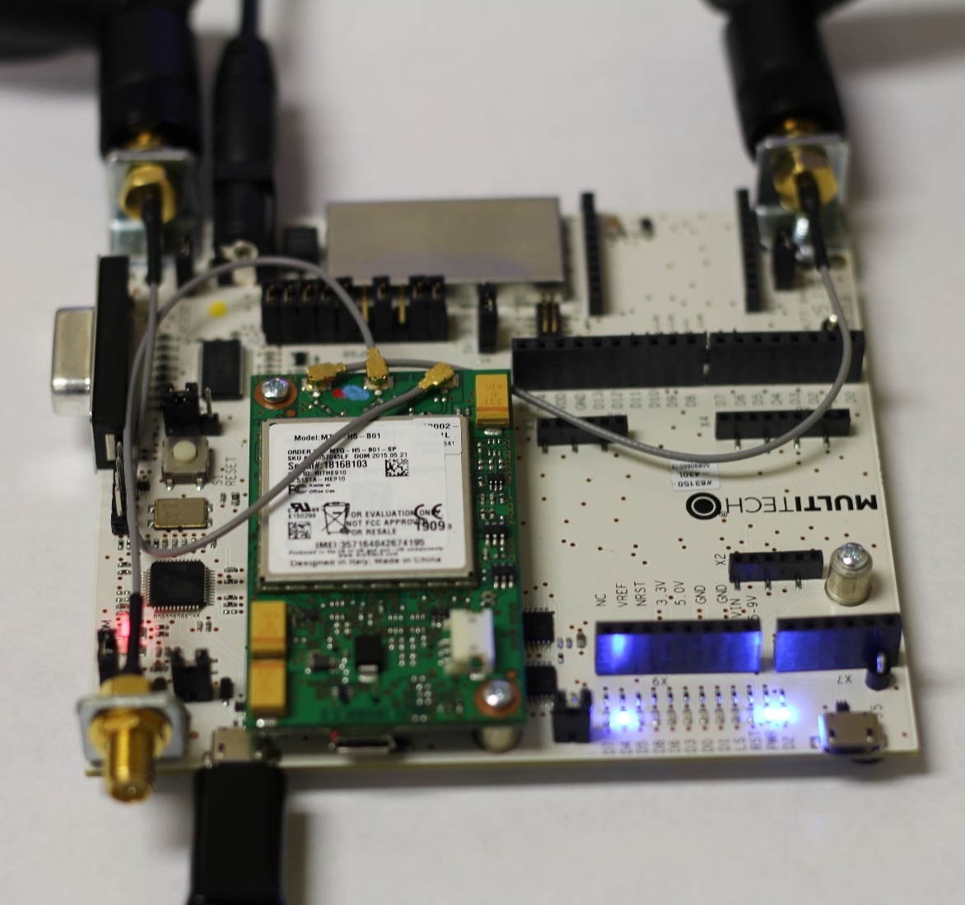

Slide 15
Cables and Power
SIM Card should be in Dragonfly
UFL Connectors should be attached (or shorting out power)
Cell Antenna are attached on the right and left cables. GPS is in the center
Apply DC Power
USB Cable
Wait.… Device drivers may take a period of time to load.
A MULTITECH Drive “D:” should appear.
Login to mbed.org
Open https://developer.mbed.org/betamode/?pre=newboards
Click on blue box “Beta Mode” end of page
Go back to mbed.org, Click on Developer, Click on Compiler.
You should see Beta Mode in top right corner

Slide 16
Hello World
Yes it’s silly, but lets get the LED to blink and test TeraTerm.
In mbed.org session. (home, compiler, verify the right board is there).
Double Click DragonflyHelloWorld
Double Click on main.cpp
Modify the code as you see fit
Click on Compile, Save the file to your favorite location, Open the download folder
Right Click and Send the new file to the MULTITECH Drive:. The RG LED should be on for a few seconds during the download process. The small Blue LEDs should be blinking.
Start Teraterm, Click on Serial, Select the right PORT.
Settings: Setup, Serial, values are: Baud rate: 9600, Data: 8, Parity: N, Stop: 1,Flow: none.
You should see Hello World! Every 5 seconds. You can adjust variables in Main.cpp.

Slide 17
LAB: Get the Modem on the Network
AT Commands are still valid.
Tasks
Set up the APN.
Cell signal strength.
Verify device is on the network (Ping Google)
Send a text to your phone.
Receive a text from your phone.

Slide 18
Dragonfly_Terminal
Double Click Dragonfly_Terminal
Double Click on main.cpp
Modify the code?: Serial port connection – do nothing.
USB: Change line 5 to Serial ext(USBTX, USBRX);
Click on Compile, Save the file to your favorite location, Open the download folder, Right Click and Send the new file to the MULTITECH Drive:.
Add a USB cable to D.fly USB connector. Wait for the drivers
Start Teraterm, Click on Serial, Select the CORRECT PORT. (the “ “ one)
  Settings: Setup, Serial, values are:
  Baud rate: 230400(serial) 115200(Dfly USB), Data: 8, Parity: N, Stop: 1,Flow: none. ECHO may need to be turned On (Terminal)

Slide 19
Dragonfly_Terminal and AT Commands
NOTE: BACKSPACE will cause the instructions to FAIL. Just hit enter and re-type
  at [if working, command responds with “OK”]
  at+cpin? [Check SIM is detected] READY
  at+cgdcont=1,”IP”,”aer.aerisapn.net” [programs SIM APN into modem]
  at+cgdcont? [verify APN is correct]
  at+csq [Check signal strength >10, but 8 will still work]
  at+creg? [Check for successful network registration] +CREG:0,1 or +CREG:0,5
  at+cnmi=2,2,0,1,0 [Configure to route received SMS text direct to serial interface]
  at+cmgf=1 [text mode for SMS]
  at+cmgs=”1##########”<cr> [enter phone number # to send SMS text message]
  >type sms message at greater than prompt<Control-Z> to send
Verify SMS is received. On phone that received SMS, respond by sending SMS back to modem number.
DRAT need to get text working
Notes:
At+creg? Responses
-------------------------
+CREG: 0,2 not registered to a network but looking (device hasn’t established a link to the carrier yet)
+CREG: 0,1 registered on the home network
+CREG: 0,5 registered but roaming
+CREG: 0,3 unknown (bad)
+CREG: 0,4 unknown (bad)
+CREG: 0,0 unregistered and not looking (sim isn’t: installed, inplace correctly , functional, active)
at+csq: >10 is better but it will function at lower levels.
Reference Signal Levels
0 = -113 dBm, 1 = -111 dBm, 2 = -109 dBm, 3 = -107 dBm, 4 = -105 dBm
5 = -103 dBm, 6 = -101 dBm, 7 = -99 dBm, 8 = -97 dBm, 9 = -95 dBm
10 = -93 dBm, 11 = -91 dBm, 12 = -89 dBm, 13 = -87 dBm, 14 = -85 dBm
15 = -83 dBm, 16 = -81 dBm, 17 = -79 dBm, 18 = -77 dBm, 19 = -75 dBm
20 = -73 dBm, 21 = -71 dBm, 22 = -69 dBm, 23 = -67 dBm, 24 = -65 dBm
25 = -63 dBm, 26 = -61 dBm, 27 = -59 dBm, 28 = -57 dBm, 29 = -55 dBm
30 = -53 dBm, 31 = -51 dBm

Slide 20
Send a PING
at#sgact=1,1 [verify packet data connection] CONNECT 10.123.54.21
at#ping=”www.google.com”
[Successful Ping response indicates Packet-Data is working]
If you have a server with a debug port: at#sd=1,0,7000,”xxx.xxx.xxx.xxx” [Packet-Data connect to TCP Svr xxx.xxx.xxx.xxx. on port 7000]
at#sgact=1,0 [terminate packet data connection]
NOTE: System may need to be unplugged from usb to recycle power (wait 5 seconds for pc to catchup up).
NOTE: Terminal may hang at random times, close and restart may be required. (or Alt+i, Alt+n)

Slide 21
Send a SMS inside mbed using MultiTech.h
Double Click on: MTSAS_Cellular_SMS_Example
Same text message but using C code and MuliTech commands
mbed web Program workspace double Click the program “MTSAS_Cellular_SMS_Example”
Edit main.cpp then Add the APN to line 11 “Fast.t-mobile.com”
Compile, Save, Find the file “MTS_Cellular_SMS_Example.bin” Right Click and send to “MULTITECH Drive:.)”
Run a Terminal emulation program (e.gTeraTerm, HyperTerminal, minicom).
Configure terminal emulation the PC Terminal program for 9600bps, 8, None, 1 and select the correct Com port.
* Terminal will show when the device sends the message and when a reply is sent.
* The send message can take some time. Just wait.
* Terminal programs may need to reset between downloads (They get lost at times).
* The dev kit may need to be unplugged to reset, wait 5-10 seconds to allow pc to clean up connections.
Reply to the text your phone receives
DRAT need to get text working

Slide 22
Why did I spend all that time with
AT Commands?

Slide 23
LAB 2 mbed Instructions for Dragonfly / ST Sensor

Slide 24
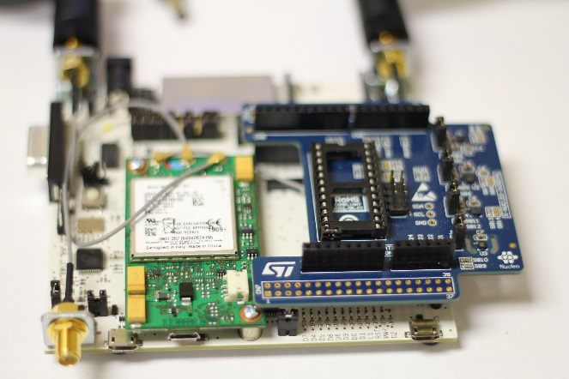
Replace Grove with STMicro Sensor Board
Unplug the UDK from power, remove the Grove Board,
Replace the Grove board with ST Sensor board
Plug Power then USB into the system.
Go to Compiler, Find the “Dragonfly_ST_Mems” program to bring it into your Program Workspace.
Compile, Save, Download file to MULTITECH Drive:
(Chrome: Ctrl+J shows the file location)
Run Teraterm (
Configure the PC Terminal program for 9600bps, 8, None, 1 and
select the correct Com port.
The terminal will show you the values of senor data.
Z is vertical
X is the USB Programming side of the board
Y is the RS232 side of the board.
Commit the code. Without breaking the system. Try to see if the board can detect a free fall. Or Enable other sensors.

Slide 25
LAB 3 mbed Instructions for
Dragonfly/ Sensor/ Aeris Sim

Slide 26
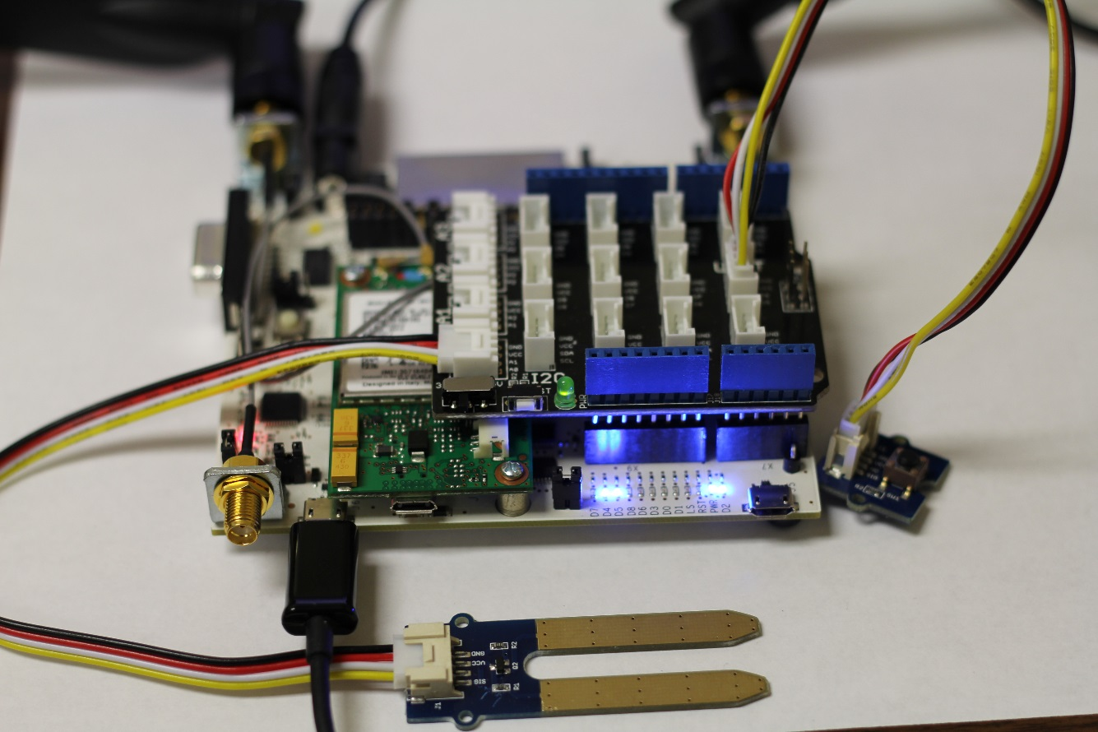
Connection Locations
Moisture Sensor Lab
Attach the Grove Shield to the MultiTech UDK
Attach the Moisture to A0
Attach the button to D5

Slide 27
Dragonfly_Moisture
In the program Click Dragonfly_Moisture and Double Click main.cpp.
In Line 22 change the number to your cell phone
Change the APN to aer.aerisapn.net
Click Compile and Send to MULTITECH Drive:
Start Terminal Program and select serial port
Try changing the value of the meter.
DRAT need to get text working

Slide 28
Breathalyzer Demo

Slide 29
15 Minute Break

Slide 30
LAB 4 mbed Instructions for Sending data to the Cloud
Aeris Aerport / Sensor/ Dragonfly

Slide 31
LAB 4: IoT Platform
Tasks
Download the Program
Aeris Navigation/Creation
Finding the data

Slide 32
Finding the Program
Go to: http://developer.mbed.org/teams/AerCloud/code/Aeris_Multitech_Moisture_Alcohol/
Import the program
Open main.cpp for editing
In a new window (easier with a new window vs tab) open Go To https://aerport.aeris.net
Login id: aercloud.trainee@aeris.net Password: A3r1s
Needs Work

Slide 33
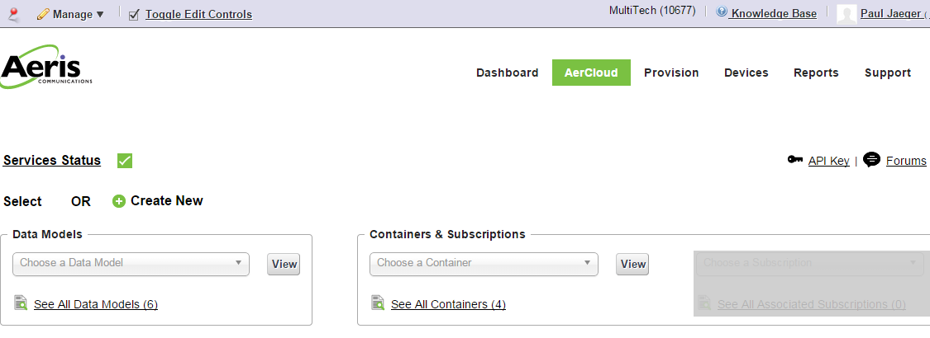
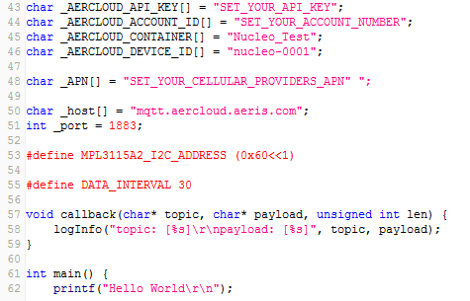
Aeris Aerport 2b
Click “AerCloud“ (top of page)
Copy the Company number to _ACCOUNT_ID
Click “API Key“ (just under and to the right of Company number)
Copy the large random number of “Account”
to _API_KEY
Add the Cellular APN
Create a name for _Device_ID
Note _Container_ID will be set later.
Needs Work

Slide 34
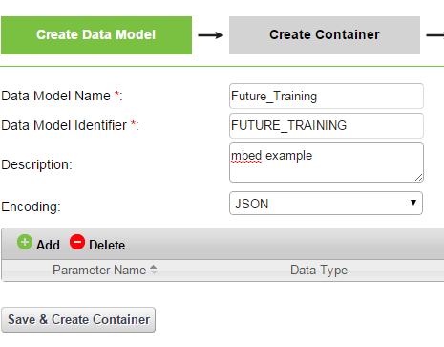
Aeris Aerport
Go back to AerCloud tab.
Click “Create New“ select “Data Model”
Add the Data Model Name (no spaces)
Data Model Identifier is added.
Add Description is you wish
Encoding must be JSON
Needs Work

Slide 35
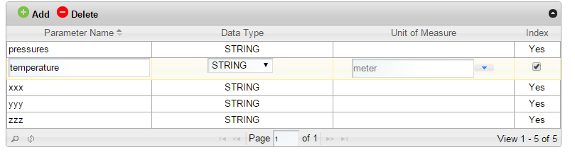
Aeris Aerport
Click on Add
Enter the sensor names
xxx, yyy, zzz as STRING
Enter the sensor names
pressure, temperature as FLOAT
Check “Index” if the data is to be sorted.
Click Save
Needs Work

Slide 36
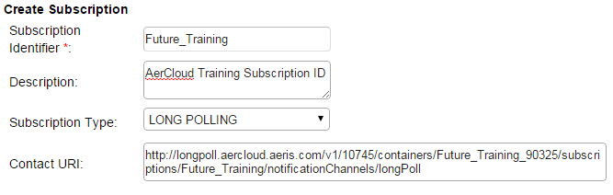
Aeris Create Container & Subscription
Create a unique Container Identifier
“Future_Training_xxxxxxx”
(IMEI Number on Socket Modem)
Modify mbed _Container_ID to the same unique name
Click on Save& Add Subscription
Add Subscription tab: Click “Create”
Create a Title and Add to the mbed program
Change Subscription Type “LONG POLLING”
Contact URL should match the mbed program variables. Copy the URL in the program as a reference.
Click Save. Go back to Dashboard
Needs Work

Slide 37
Compile & Data
Compile the program and Download to Platform (same process as before)
Start TeraTerm on the right Com Port
Double Click on the HTTP web address from the terminal program.
This is the Long Poll Location of the data from the sensor.
The web browser may clock while waiting for data to show up from the mbed demo. Refresh as needed.
Needs Work

Slide 38
LAB Review
Where to find/Is it repeatable/What do you need?

Slide 39
Dragonfly (MTQ) pin out assignments
MTQ Pin | MTQ Name | UDK 2.0 Arduino pin | mbed GPIO | Programming Interface | SPI Interface | I2C Interface | USARTs | Timer functions | SDIO Functions | ADC Channels
1 | DBG_TX (mbed dbgTX) |  | PB_6 |  |  | I2C1_SCL | USART1_TX | TIM4_CH1
2 | J_TCK/SWCLK |  | PA_14 | JTCK-SWCLK
3 | J_TDI/C_MON |  | PA_15 | JTDI | SPI1_NSS |  | USART1_TX | TIM2_CH1/TIM2_ETR
4 | J_RST/P_GOOD |  | PB_4 | JTRST | SPI1_MISO | I2C3_SDA |  | TIM3_CH1 | SDIO_D0
9 | IO_00/RXD | D1 | PA_2 |  |  |  | USART2_TX | TIM2_CH3, TIM5_CH3, TIM9_CH1 |  | ADC1_2
10 | IO_01/DCD | D4 | PA_7 |  | SPI1_MOSI |  |  | TIM1_CH1N, TIM3_CH2 |  | ADC1_7
11 | IO_02/RI | D8 | PB_1 |  |  |  |  | TIM1_CH3N TIM3_CH4, |  | ADC1_9
12 | IO_03/CTS | D6 | PA_1 |  |  |  | USART2_RTS | TIM2_CH2, TIM5_CH2 |  | ADC1_1
14 | IO_04/MOSI | D11 | PB_5 |  | SPI1_MOSI | I2C1_SMBA |  | TIM3_CH2 | SDIO_D3
15 | IO_05/SCK | D13 | PA_5 |  | SPI1_SCK |  |  | TIM2_CH1/TIM2_ET |  | ADC1_5
16 | IO_06/SCL/SS1 | D15 | PB_8 |  |  | I2C1_SCL, I2C3_SDA |  | TIM4_CH3, TIM10_CH1
17 | IO_07 | D2 | PB_15 |  | SPI2_MOSI |  |  | TIM1_CH3N | SDIO_CK
18 | IO_08 | A0 | PC_2 |  | SPI2_MISO |  |  |  |  | ADC1_12
19 | IO_09 | A3 | PB_0 |  |  |  |  | TIM1_CH2N, TIM3_CH3 |  | ADC1_8
20 | IO_10 | A1 | PC_0 |  |  |  |  |  |  | ADC1_10
21 | IO_11 | A4 | PC_1 |  |  |  |  |  |  | ADC1_11
22 | IO_12 | A2 | PC_4 |  |  |  |  |  |  | ADC1_14
23 | IO_13 | D9 | PB_13 |  | SPI2_SCK |  |  | TIM1_CH1N
24 | IO_14 | A5 | PC_9 |  |  | I2C3_SDA |  | MCO_2, TIM3_CH4 | SDIO_D1
25 | IO_15/SDA/SRDY | D14 | PB_9 |  | SPI2_NSS | I2C1_SDA |  | TIM4_CH4, TIM11_CH1
26 | IO_16/MISO | D12 | PA_6 |  | SPI1_MISO |  |  | TIM1_BKIN, TIM3_CH1 | SDIO_CMD | ADC1_6
27 | IO_17/SS2 | D10 | PC_8 |  |  |  |  | TIM3_CH3 | SDIO_D0
29 | IO_18/RTS | D3 | PA_0 (WKUP) |  |  |  | USART2_CTS | TIM2_CH1/TIM2_ET, TIM5_CH1, |  | ADC1_0
30 | IO_19/DSR | D5 | PA_9 |  |  | I2C3_SMBA | USART1_TX | TIM1_CH2 | SDIO_D2
31 | IO_20/DTR | D7 | PA_8 |  |  | I2C3_SCL |  | MCO_1, TIM1_CH1 | SDIO_D1
32 | IO_21/TXD | D0 | PA_3 |  |  |  | USART2_RX | TIM2_CH4, TIM5_CH4, TIM9_CH2 |  | ADC1_3
38 | J_TDO/SWO |  | PB_3 | JTDO-SWO | SPI1_SCK |  | USART1_RX | TIM2_CH2
39 | J_TMS/SWDIO |  | PA_13 | JTMS-SWDIO
40 | DBG_RX (mbed dbgRX) |  | PB_7 |  |  | I2C1_SDA | USART1_RX | TIM4_CH2 | SDIO_D0

Slide 40
Dragonfly (MTQ) pin out assignments
MTQ Pin | MTQ Name | UDK 2.0 Arduino pin | mbed GPIO | Programming Interface | SPI Interface | I2C Interface | USARTs | Timer functions | SDIO Functions | ADC Channels
1 | DBG_TX (mbed dbgTX) |  | PB_6 |  |  | I2C1_SCL | USART1_TX | TIM4_CH1
2 | J_TCK/SWCLK |  | PA_14 | JTCK-SWCLK
3 | J_TDI/C_MON |  | PA_15 | JTDI | SPI1_NSS |  | USART1_TX | TIM2_CH1/TIM2_ETR
4 | J_RST/P_GOOD |  | PB_4 | JTRST | SPI1_MISO | I2C3_SDA |  | TIM3_CH1 | SDIO_D0
9 | IO_00/RXD | D1 | PA_2 |  |  |  | USART2_TX | TIM2_CH3, TIM5_CH3, TIM9_CH1 |  | ADC1_2
10 | IO_01/DCD | D4 | PA_7 |  | SPI1_MOSI |  |  | TIM1_CH1N, TIM3_CH2 |  | ADC1_7
11 | IO_02/RI | D8 | PB_1 |  |  |  |  | TIM1_CH3N, TIM3_CH4 |  | ADC1_9
12 | IO_03/CTS | D6 | PA_1 |  |  |  | USART2_RTS | TIM2_CH2, TIM5_CH2 |  | ADC1_1
14 | IO_04/MOSI | D11 | PB_5 |  | SPI1_MOSI | I2C1_SMBA |  | TIM3_CH2 | SDIO_D3
15 | IO_05/SCK | D13 | PA_5 |  | SPI1_SCK |  |  | TIM2_CH1/TIM2_ET |  | ADC1_5
16 | IO_06/SCL/SS1 | D15 | PB_8 |  |  | I2C1_SCL, I2C3_SDA |  | TIM4_CH3, TIM10_CH1
17 | IO_07 | D2 | PB_15 |  | SPI2_MOSI |  |  | TIM1_CH3N | SDIO_CK
18 | IO_08 | A0 | PC_2 |  | SPI2_MISO |  |  |  |  | ADC1_12
19 | IO_09 | A3 | PB_0 |  |  |  |  | TIM1_CH2N, TIM3_CH3 |  | ADC1_8
20 | IO_10 | A1 | PC_0 |  |  |  |  |  |  | ADC1_10
21 | IO_11 | A4 | PC_1 |  |  |  |  |  |  | ADC1_11
22 | IO_12 | A2 | PC_4 |  |  |  |  |  |  | ADC1_14
23 | IO_13 | D9 | PB_13 |  | SPI2_SCK |  |  | TIM1_CH1N
24 | IO_14 | A5 | PC_9 |  |  | I2C3_SDA |  | MCO_2, TIM3_CH4 | SDIO_D1
25 | IO_15/SDA/SRDY | D14 | PB_9 |  | SPI2_NSS | I2C1_SDA |  | TIM4_CH4, TIM11_CH1
26 | IO_16/MISO | D12 | PA_6 |  | SPI1_MISO |  |  | TIM1_BKIN, TIM3_CH1 | SDIO_CMD | ADC1_6
27 | IO_17/SS2 | D10 | PC_8 |  |  |  |  | TIM3_CH3 | SDIO_D0
29 | IO_18/RTS | D3 | PA_0 (WKUP) |  |  |  | USART2_CTS | TIM2_CH1/TIM2_ET, TIM5_CH1 |  | ADC1_0
30 | IO_19/DSR | D5 | PA_9 |  |  | I2C3_SMBA | USART1_TX | TIM1_CH2 | SDIO_D2
31 | IO_20/DTR | D7 | PA_8 |  |  | I2C3_SCL |  | MCO_1, TIM1_CH1 | SDIO_D1
32 | IO_21/TXD | D0 | PA_3 |  |  |  | USART2_RX | TIM2_CH4, TIM5_CH4, TIM9_CH2 |  | ADC1_3
38 | J_TDO/SWO |  | PB_3 | JTDO-SWO | SPI1_SCK |  | USART1_RX | TIM2_CH2
39 | J_TMS/SWDIO |  | PA_13 | JTMS-SWDIO
40 | DBG_RX (mbed dbgRX) |  | PB_7 |  |  | I2C1_SDA | USART1_RX | TIM4_CH2 | SDIO_D0

